Slide 1
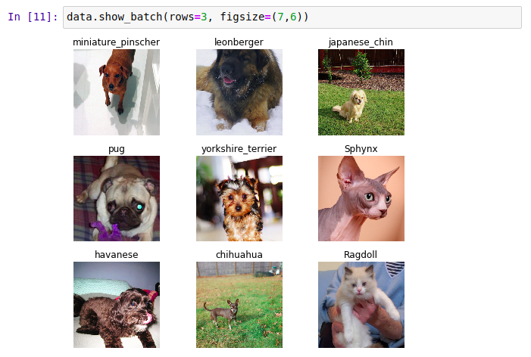
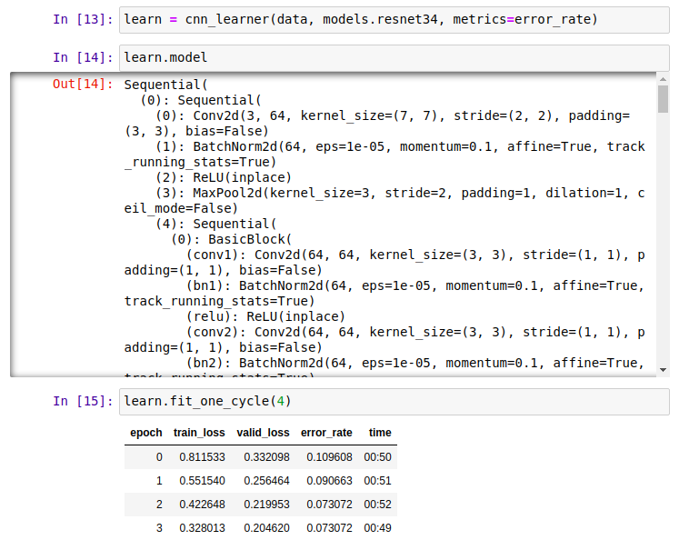
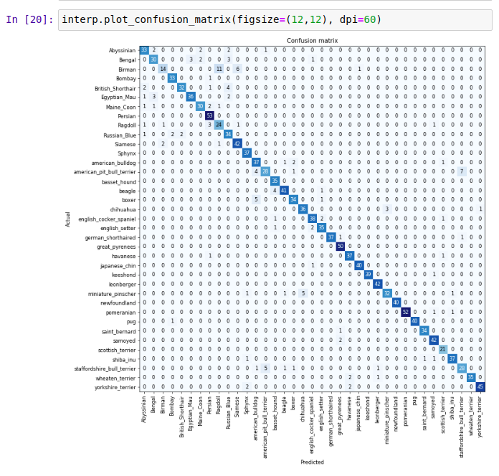

fast.ai
Making neural nets
uncool again
Josiah Laivins
February 23, 2020

Slide 2
Making Deep Learning Accessible
Software
To make these available to use quickly, reliably, and with minimal code
Community
So that we can all help each other
Research
Ways to make state of the art deep learning techniques more accessible
Research
So that as many people as possible use these
Description from: https://course.fast.ai/videos/?lesson=1

Slide 3
Black Box
Interpretable ML
Visualize Gradients and activations
Needs too much data
Transfer learning
Share pre-trained nets
Needs ML PhD
No longer true
Fastai & keras libs MOOCs, etc
Only for vision
No longer true
SoTA for speech, structured data, time series...
Needs lots of GPUS
Was never true
… except for some research projects
"Not really AI"
Who cares
Do you really want to build a brain
Description from: https://course.fast.ai/videos/?lesson=1

Slide 4
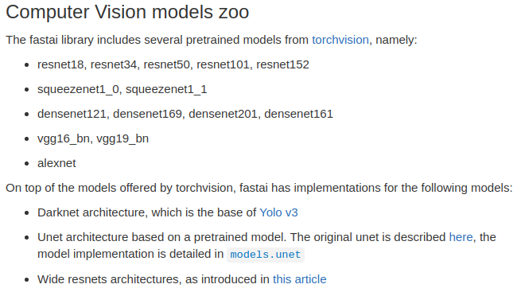
fast.ai
Vision models
Ref: https://docs.fast.ai/vision.models.html

Slide 5
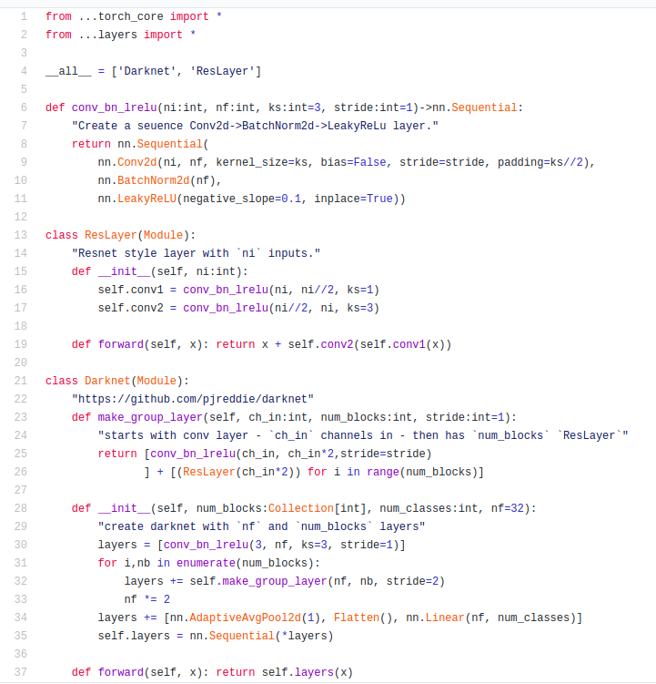
Darknet implimentation example
Ref: https://github.com/fastai/fastai/blob/master/fastai/vision/models/darknet.py

Slide 6
I wanna make my own model!
Trainer
If your model involves a novel way of training.
Learner
Needed if you have a new model and new Training method.
Model
If your model is simply a pytorch Module.
DataBunch
If there is a new way of handling data.
[1]: https://github.com/fastai/fastai/blob/master/fastai/vision/gan.py
[2]: https://docs.fast.ai/vision.gan.html
[3]: https://github.com/josiahls/fast-reinforcement-learning/blob/master/fast_rl/agents/dqn.py

Slide 7
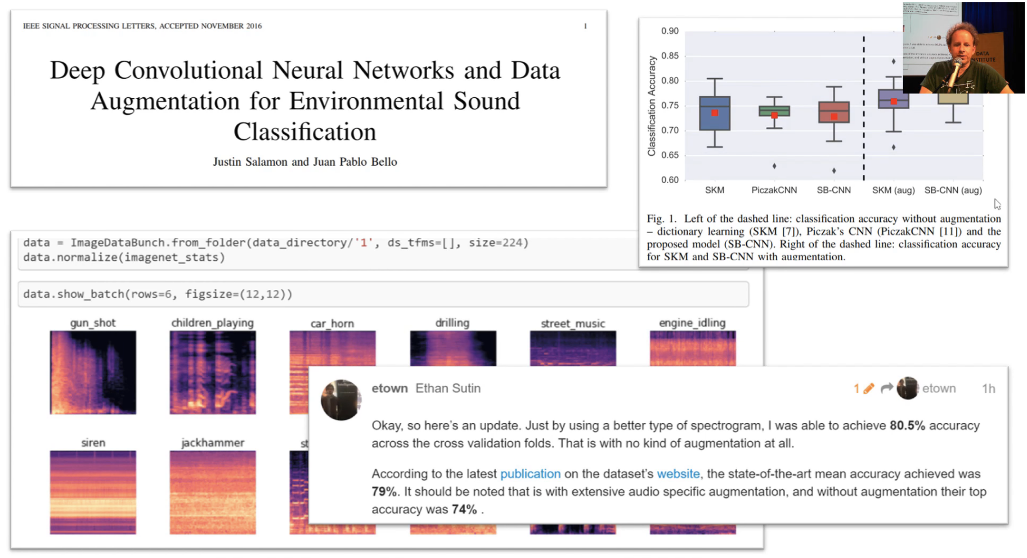
[1]: https://github.com/hiromis/notes/blob/master/Lesson2.md
[2]: https://forums.fast.ai/t/share-your-work-here/27676/215

Slide 8
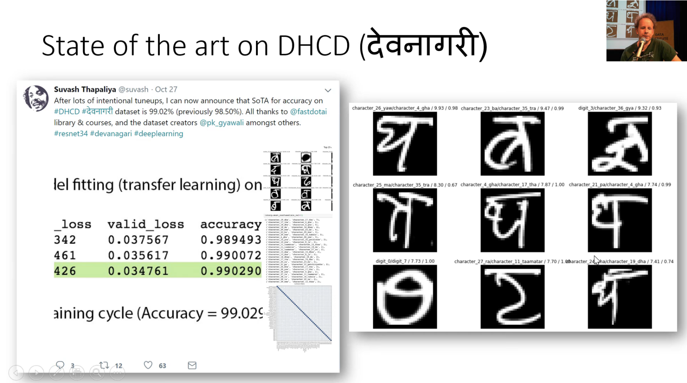
[1]: https://github.com/hiromis/notes/blob/master/Lesson2.md
[2]: https://forums.fast.ai/t/share-your-work-here/27676/38

Slide 9
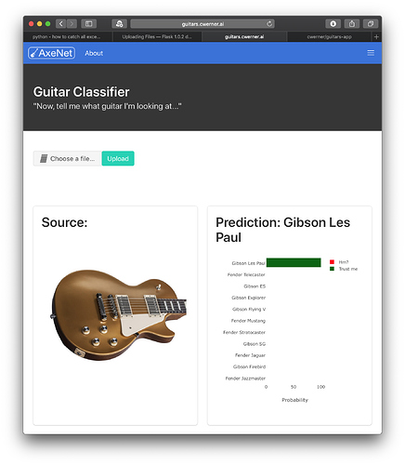
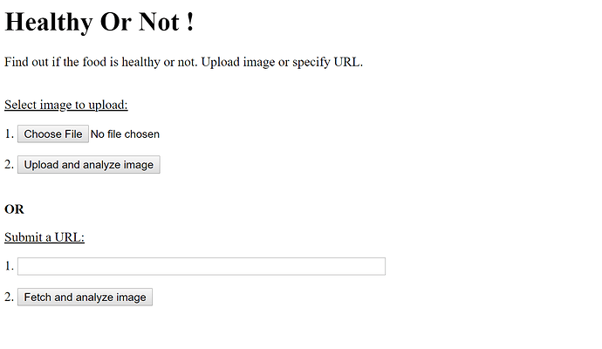
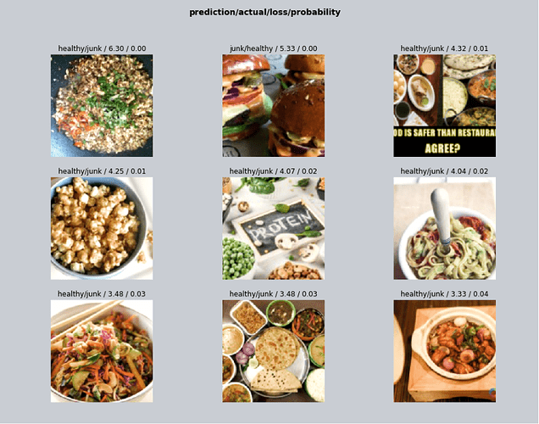
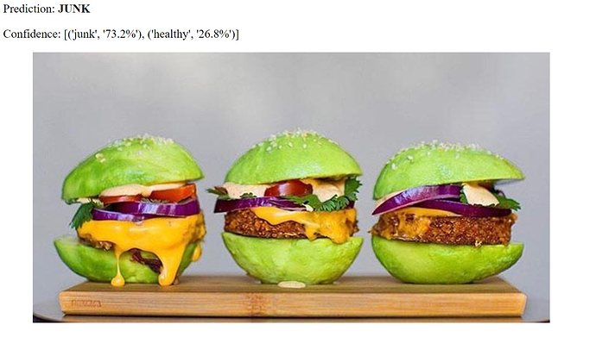
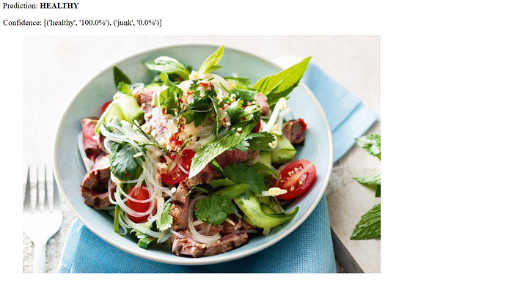
Guitar Classifier
Junk or Health Food Classifier
[1]: https://github.com/hiromis/notes/blob/master/Lesson3.md
[2]: https://forums.fast.ai/t/share-your-work-here/27676/399
[2]: https://forums.fast.ai/t/share-your-work-here/27676/340

Slide 10
fast.ai not just classification

Slide 11
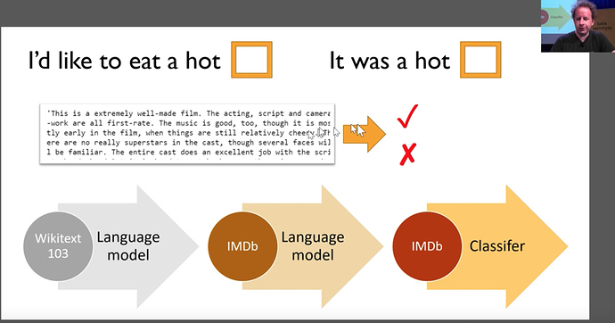
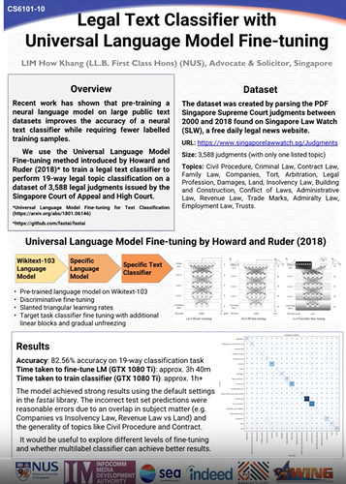
NLP
Movie Review Sentiment Classification
Legal Document Classification
[1]: https://forums.fast.ai/t/deep-learning-lesson-4-notes/30983

Slide 12
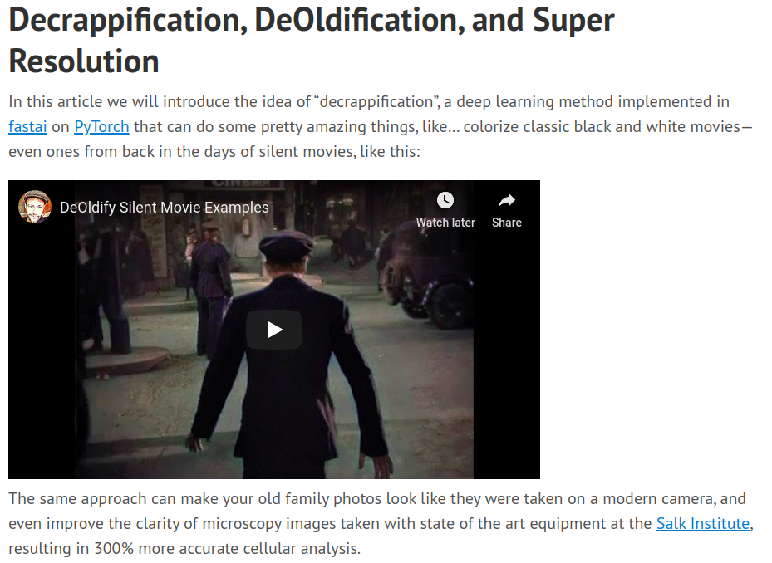
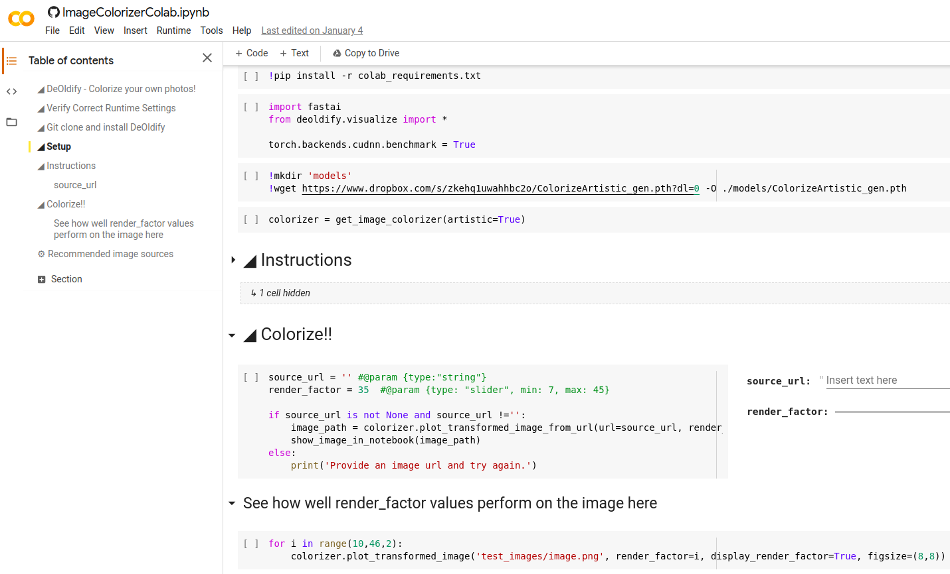
GANs
DeOldify
Colorizer
[1]: https://www.fast.ai/2019/05/03/decrappify/
[2]: https://colab.research.google.com/github/jantic/DeOldify/blob/master/ImageColorizerColab.ipynb#scrollTo=LHfUPH42O_iK

Slide 13
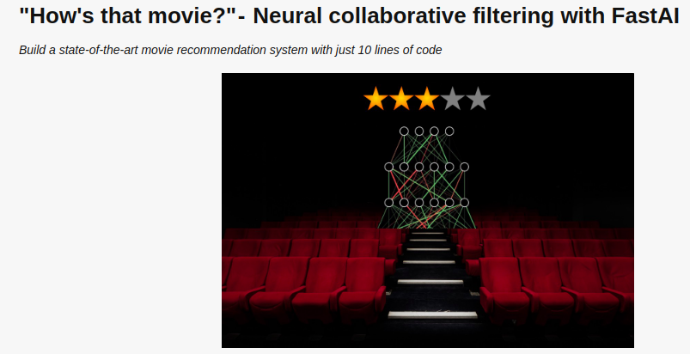
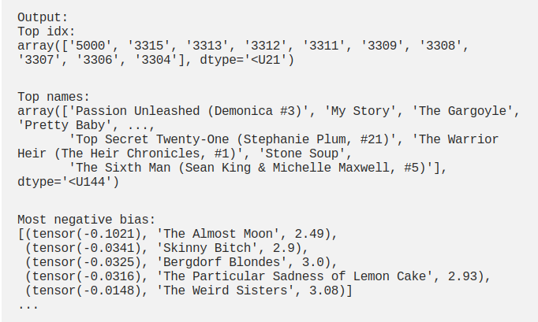
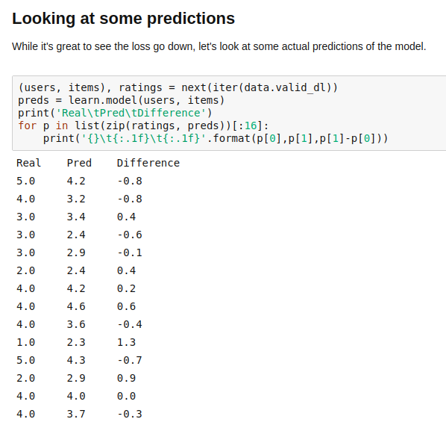
Collaborative Filtering
Movie Recommendation System
Book Recommendation System
[1]: https://course.fast.ai/videos/?lesson=4
[2]: https://towardsdatascience.com/collaborative-filtering-with-fastai-3dbdd4ef4f00
[3]: https://jovian.ml/aakashns/5bc23520933b4cc187cfe18e5dd7e2ed

Slide 14
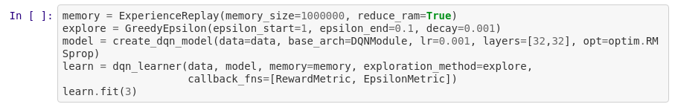
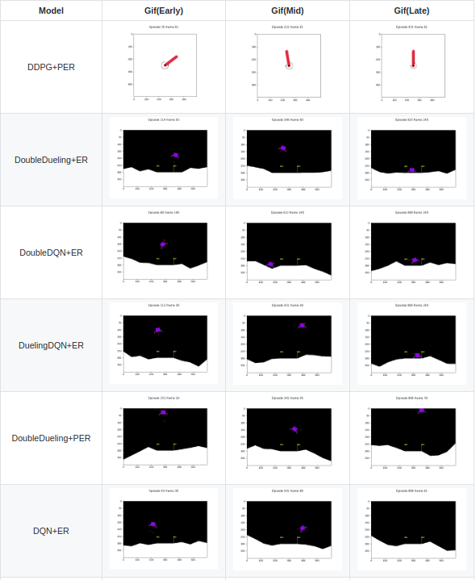
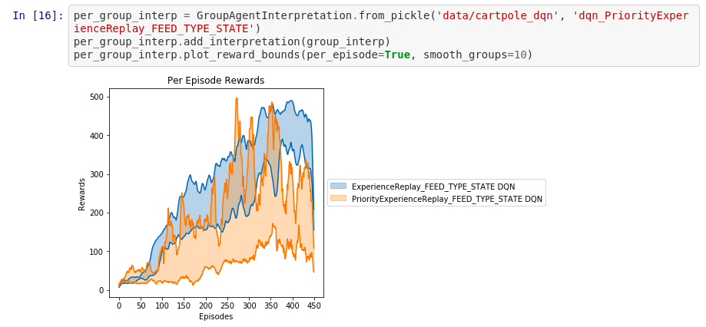
Reinforcement Learning (experimental)
[1]: https://github.com/josiahls/fast-reinforcement-learning

Slide 15
fast.ai has a MOOC!

Slide 16
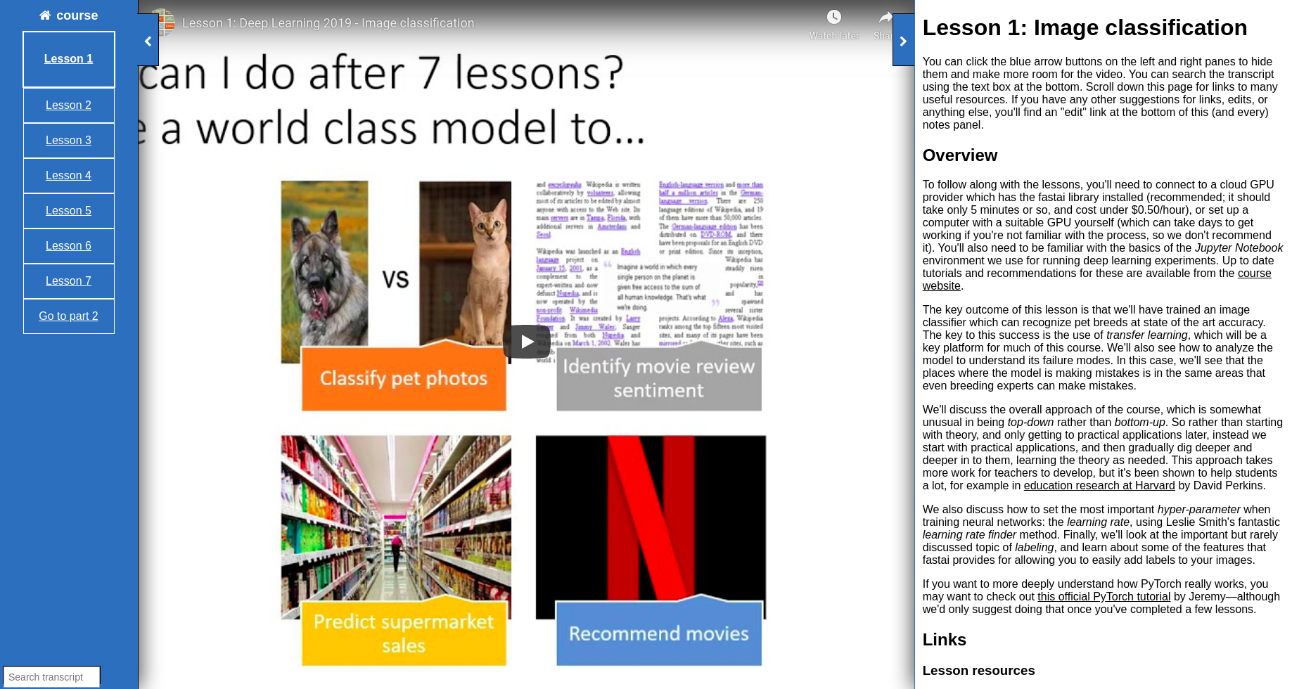
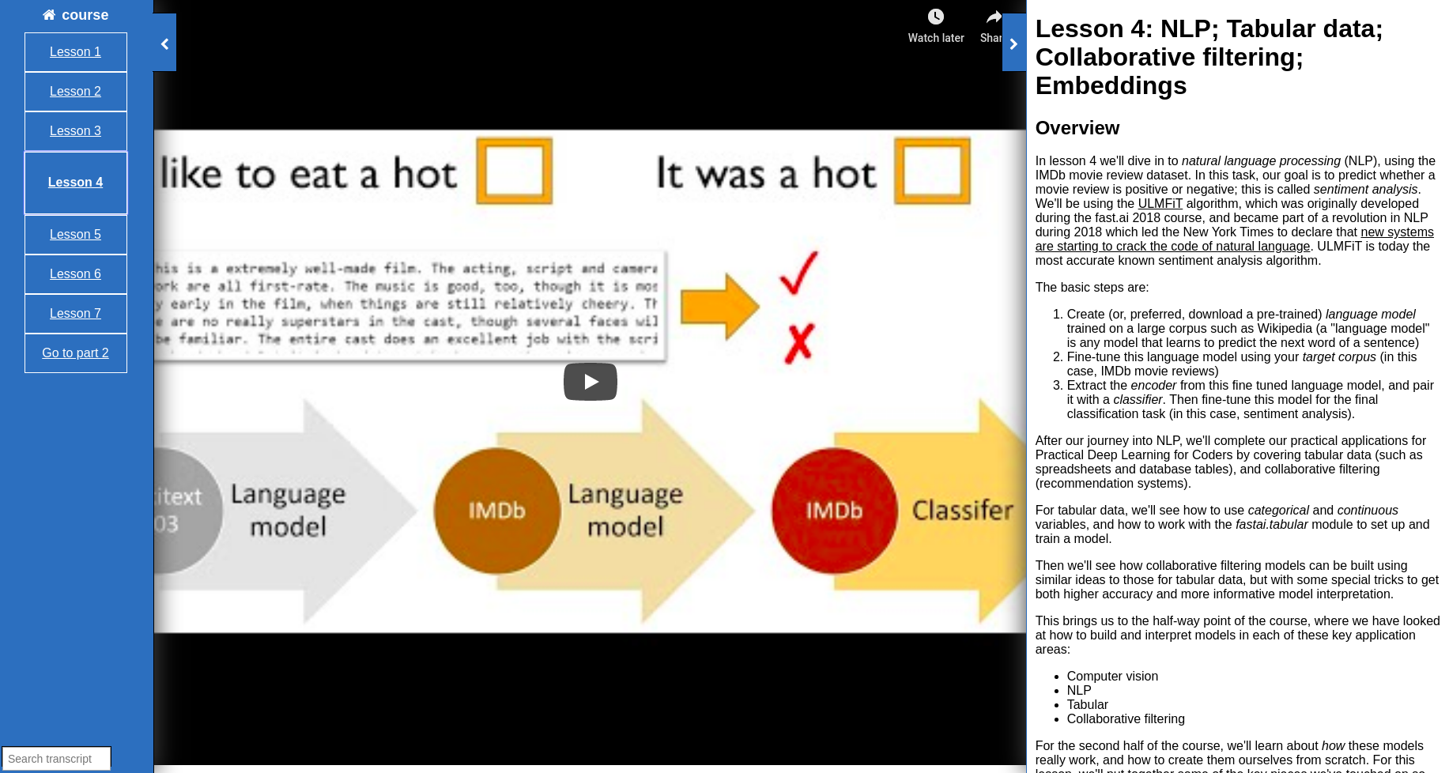
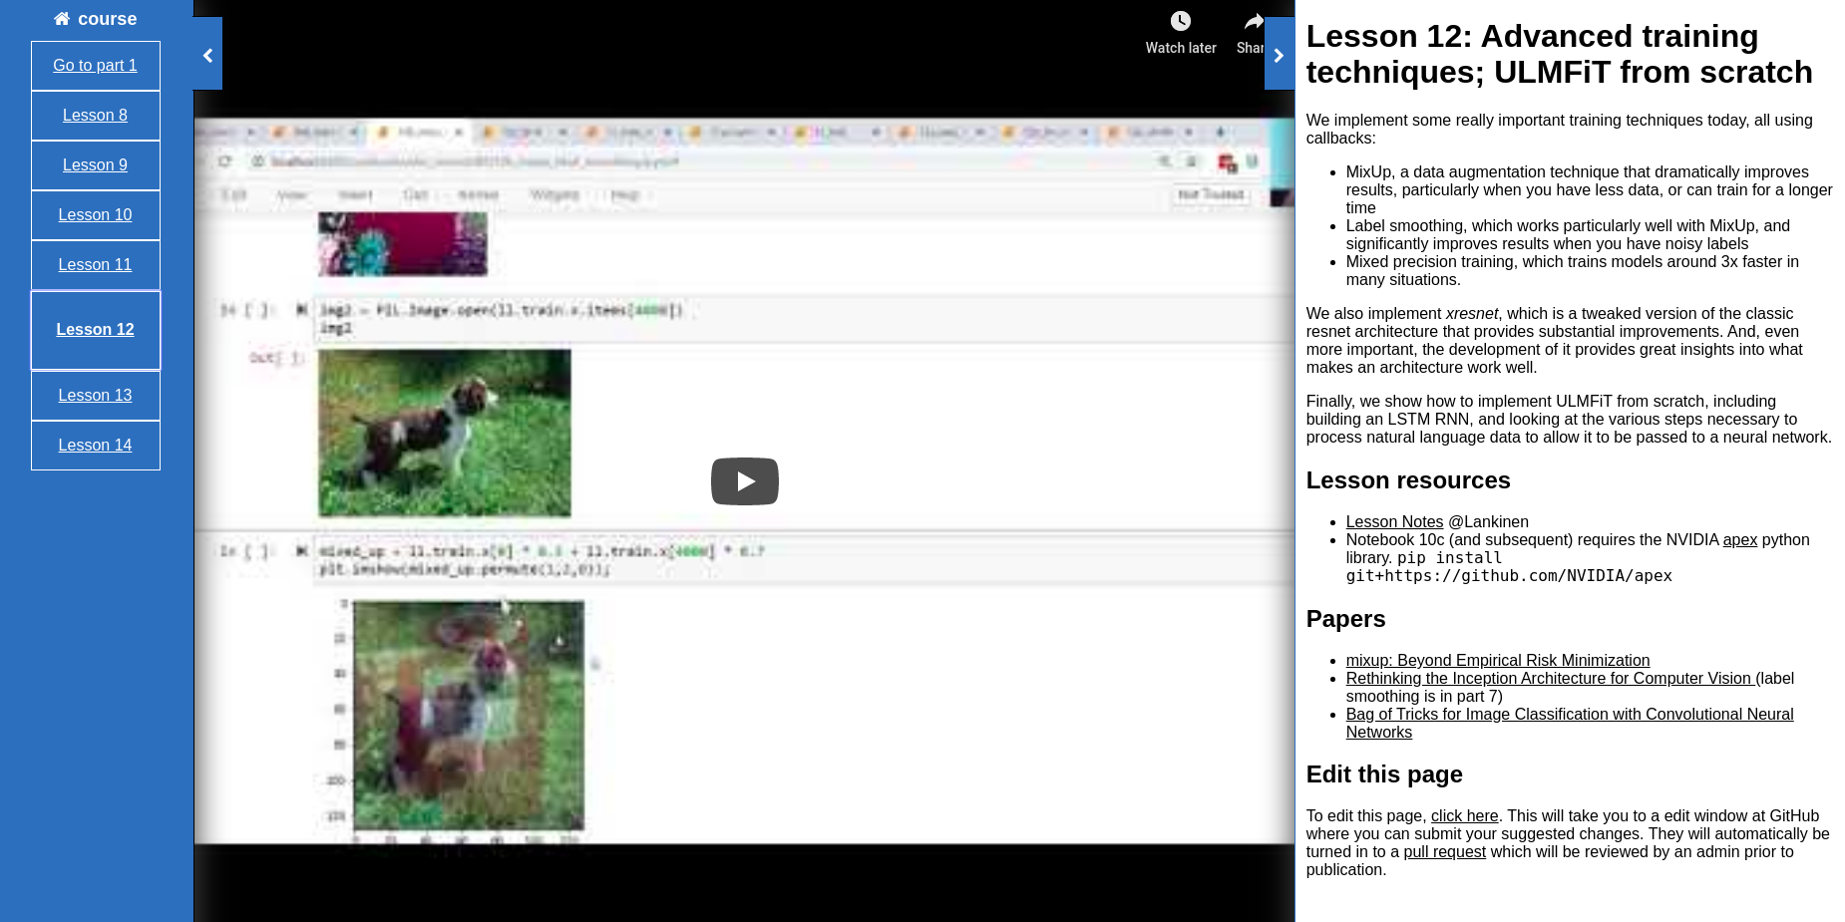
[1]: https://course.fast.ai/videos/?lesson=1

Slide 17
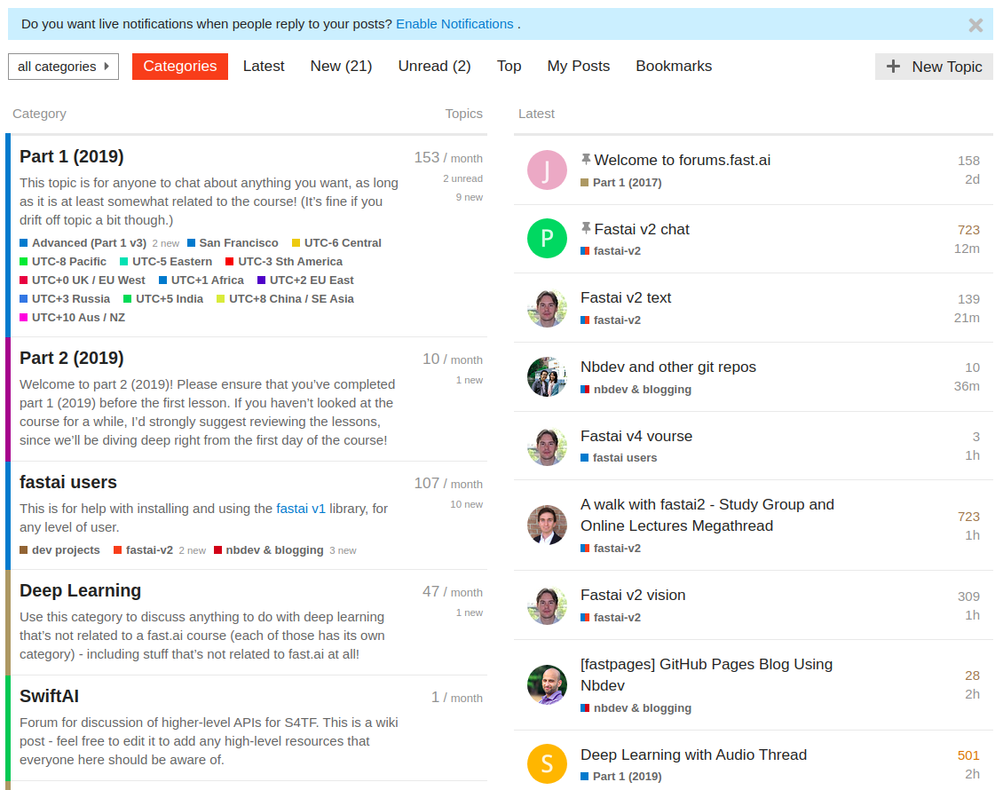

[1]: https://forums.fast.ai/
[2]: https://www.usfca.edu/data-institute/certificates/deep-learning-part-one

Slide 18
Thank you!

